Slide 1
Relationships between Police and Young People

Slide 2
Who we are?
Our Vision is for a happier, healthier and safer place which we will deliver via our mission of building a better system of children and young people’s services in Hammersmith and Fulham.
This will be by improving partnerships and coordination between services, increasing funding and resources for organisations, and by providing a ‘go to’ for high-quality information for Members, Partners and the public.

Slide 3
Our aims
• We will produce on-going insight to provide the current and evolving views of young people to widen the appreciation of young people as a demographic.
• We will raise funds for our membership to provide high-quality services for young people
• We will actively introduce and support youth organisations to work together, and this will lead to a more positive impact for children and young people.

Slide 4
Problem Statement
‘Young People and the police in H & F can have a negative relationship. This was highlighted to us during a meeting where a question from a young person sparked a response that was a snapshot of how police can react to young people.
Add this to the difficulties around disproportionality, stop and search and police reputations, it provides a purpose to try and find a better solution to the current situation’

Slide 5
What have we done?
Conducted a peer research report called ‘Growing up in H & F’
Seven peer researchers all aged under 25
Carried out in-depth interviews with eight young people
Surveyed 594 young people, use of Instagram was vital for reach

Slide 6
What have we done?
Worked with students from Imperial College on three thematic reports:
Childhood Obesity
Multi agency approaches to Serious Youth Violence
Mental Health services for CYP from the African Diaspora

Slide 7
Problem Statement
‘Young People and the police in H & F can have a negative relationship. This was highlighted to us during a meeting where a question from a young person sparked a response that was a snapshot of how police can react to young people.
Add this to the difficulties around disproportionality, stop and search and police reputations, it provides a purpose to try and find a better solution to the current situation’

Slide 8
ACCOUNT Hackney Saqib Deshmukh Presentation with Q & A www.accounthackney.org

Slide 9
Next Steps….. What can we do? What should we do? What do we want to do?

Slide 10
Impact of Coronavirus on Young People
Increased mental health or wellbeing concerns
Increased loneliness and isolation
Lack of safe space – including not being able to access their youth club/ service and lack of safe spaces at home
Challenging family relationships
Lack of trusted relationships or someone to turn to
Increased social media or online pressure
Higher risk for engaging in gangs, substance misuse, carrying weapons or other harmful practices
Higher risk for sexual exploitation or grooming

Slide 11
How can the Police make you feel safer in your community? – TAKEOVER DAY 2019
Search more people (but in a justifiable and non-discriminatory way).
Be more present and look approachable (aggressive and unfriendly perception of police).
Police to be around more, out on patrol.
Building better relationships with and understanding of young people.
Come into school/talk to people.
Being around, getting more involved with the community and young people.

Slide 12
How can the Police make you feel safer in your community? - TAKEOVER DAY 2019
Have a better understanding of the issues that young people are facing from a young person’s perspective.
More awareness and sharing information on what police are doing to tackle crime and keep us safe.
More accessible places where police are and ways to contact police that young people know about.
More positive interactions rather than being just enforcement.
Police to do more workshops in schools on how we can keep ourselves safe.
Places that young people hang around to be better lit up and patrolled.

Slide 13
What makes you feel unsafe in your community?
Big groups of young people that are loud.
Dark streets, Bad lighting, and alley ways.
“Being in the wrong place at the wrong time.”
Excessive police presence.
Gangs and gang violence.
Intimidating young people.
Gangs around schools.
Going out at night.
Watching things on the news like murder, knife crime.
Hearing about young people getting stabbed/hurt locally.
Some areas have ‘dodgy’ people hanging around.

Slide 14
Next Steps….. What can we do? What should we do? What do we want to do?

Slide 15
How young people can be part of consultations?

Slide 16
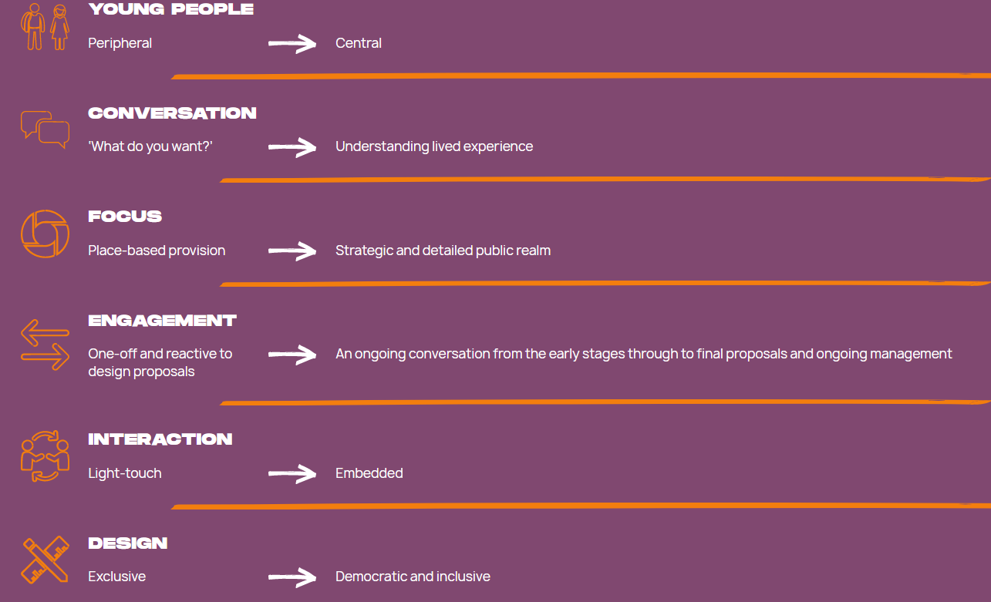
In what way and why should we engage Young People?

Slide 17
Thank you
https://yhff.org.uk/knowledge
Gareth Dixon, CEO
Gareth@yhff.org.uk
07535309343

